Slide 1
C.U. Fusion Fusing Reality into your Member Experience
Winter Owner Meeting
February 5-6, 2019

Slide 2


AR CITY VIDEO

Slide 3
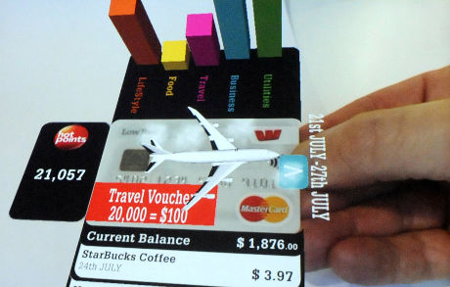
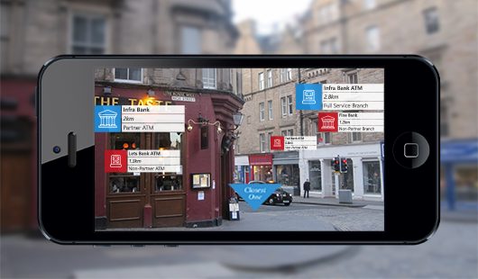
Leverage emerging technology to provide a fuller and richer engaging experience to your membership
Notes:
You will have the option to choose from using your smartphone to bring your financial experiences to life or putting on your virtual reality glasses to bring your experiences to the future.
To accommodate your members busy life, you can offer an amplified 24/7 experience that will allow you to offer access to financial services through a Augmented Reality or Virtual Reality.

Slide 4
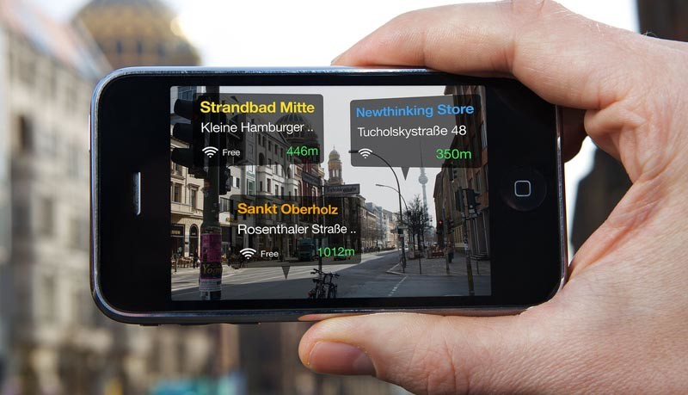

How? Through Augmented/Virtual Reality
Augmented Reality (AR) Overlays virtual objects onto the real-world
Users interact with the real world while digital content is added to it
Example: SnapChat, Pokemon Go, IKEA, etc
Virtual Reality (VR) Immersive experience into an artificial digital environment
Advanced VR allows users to move and interact in the environment
Example: Movie - Ready Player One
Notes:
Augmented / Virtual Reality is a computer generated, programmed environment where a user can sense or feel the details of a virtual world, and even execute tasks like in the actual world.

Slide 5
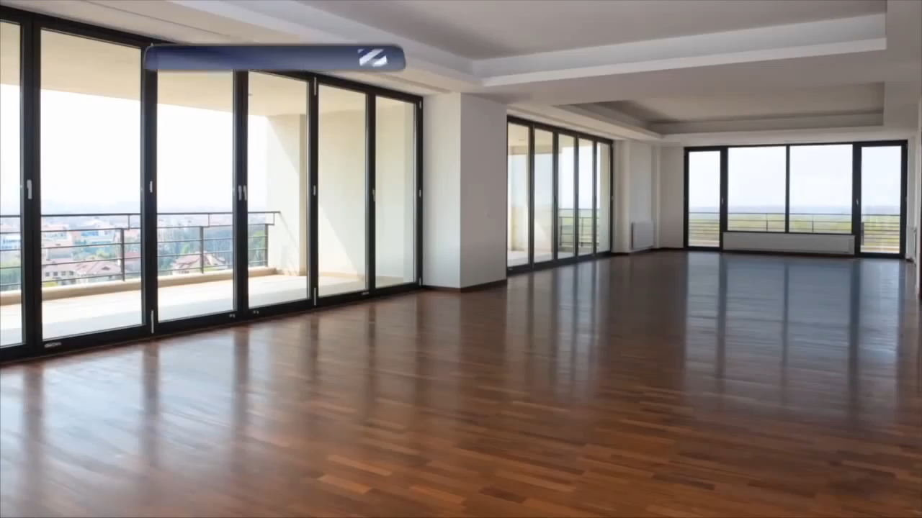
Augmented Reality in the Mainstream

Slide 6
That’s cool, but what about banking

Slide 7
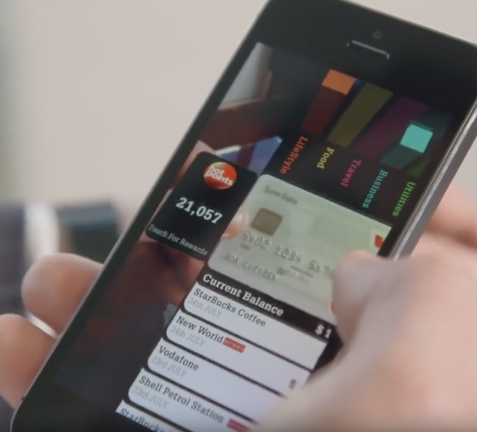
Marketplace Examples
“The 3D imagery brings banking to life delivering a quick, easy, and unique experience for the customer.”
Chief Digital Officer Simon Pomeroy
Westpac of New Zealand
Customers can:
Check their balances
See their last five transactions
Track spend locations
Categorize spending over a five week period
Be alerted when payments are due
Make payments
Check their hotpoints® balance
Find the closest Westpac NZ branch and ATM

Slide 8


Marketplace Example
The National Bank of Oman
Consumers can locate nearby ATM or branch
But more importantly, customers can also find deals while walking around the city (e.g. when in a shopping mall).
National Bank of Oman

Slide 9
The Need

Slide 10

The Need
Members want:
Information
Self service
Convenience
Innovation
Credit unions want:
To educate their members
Provide seamless services
Increase member engagement
Increase Deposits and/or Loans
Fun
Convenience
Self-
Service

Slide 11
Market Survey Results
Attribute | Aggregate | Credit Unions | Banks
Attractiveness | 52% | 44% | 61%
Likelihood to Switch | 28% | 18% | 39%
Uniqueness (How similar is this to something already in the market?) | 31% | 31% | 31%
Major Benefit
Attractiveness Breakdown:
62% of ages 18-24 were attracted to idea
Providing more information to your members.
Convenience of conducting all banking from your home (59%)
Avoid the traffic and wasted time of visiting your financial institution branch (25%)
Avoid inconvenience of waiting in line (11%)

Slide 12
AR/VR Now and Beyond
Today
Today: Appeal to Millennials & Younger Generation
73% of millennials said they are interested in virtual reality
Consider Playstation, Oculus, Snapchat, Facebook, Southwest Airlines
Near Term (2019-2020)
2018: Augmented Reality in the Mainstream
Over a billion smartphones users will create augmented reality content at least once in 2018
Billions of people are likely to view (on smartphones or other screens) AR content created on a phone
Beyond
2020
Beyond: Technology Enhancements will Drive Growth
Core enabling technologies (particularly in cameras) will continue to improve
Content will look even more photorealistic, and will have enhanced feature detection
AR revenues are expected to grow to $1B by 2020

Slide 13

Before getting to Virtual Reality, we must tackle Augmented Reality
Augmented Reality is:
Picking up steam mainstream
Who hasn’t seen a Snapchat pic?
Currently Available
Quicker to Market
Financial Institutions starting to adopt technology

Slide 14
The Opportunity

Slide 15
Impacts of AR / VR in Consumer Banking
New Payment Methods
New payment methods may be created using AR with features like extreme user experience, device independence, and seamlessness
Virtual Branch Banking
Virtual branch banking may become a reality, where the consumer will be walking into a branch from their home.
Campaigns & Advertisements
Sign-enabled product brochures, personalized marketing messages with augmented presentations, and embedded digital advertisements
Authentication and Security
Biometric authentication like voice recognition, retina scan, etc. will be widely used.
Reporting & Documentation
Statements, advice, letters, etc. may have different presentations with a focus on creating an AR experience for consumers.
Virtual Credit and Debit Cards
Truly virtual cards can provide unique transactional experience for members with added security measures.
Member Experience
Streamlined processes that optimizes the member experience.
Infosys: Future of Consumer Banking – The Augmented Way (2018)

Slide 16




Credit Union Benefits
Member Benefits
Membership Growth
Product Growth
Employee Retention
Product/Service Engagement
Loyalty Improvement
Memorable Experiences
Employee Engagement
Recruitment
Education/Training
Gamification with education
Community Event Engagement
Brand Awareness
Reduce Brick and Mortar
Address rural communities
Safer environments
24/7 Access
Enables ATM locators
Transformation of Member’s home

Slide 17
Considerations to Implement AR/VR
Member Technology Training
Data
Security
VR/AR Equipment
Notes:
Regulation and Security
Government regulation around using this form of technology (leverage NPS to define regulation) to address risk, health, security, safety concerns
Anti-Virus software and device recognition
Packaged Solutions for member based on need
All banking services available will be available through other channels within the organization (no obligation)
2. Vendor Management
Higher risk RFP process that includes consultant to manage vendor and manufacturer selection
Robust demo and pilot program
Quarterly performance reporting on class actions, incident reports and risk management
Training and Onboarding
Leverage consultant to assist with training for member and employees
Build safe room for employee/members to have ‘hands on learning’ and to test drive the experience
Overcoming objections and technology issues

Slide 18
Execution Two-phased Approach
1
2
Augmented Reality
Virtual Reality

Slide 19
Execution Phase One
1
Augmented Reality
Create an enhanced Member experience through a mobile app.
Marketing (in branch, offsite, SEGs, etc)
Credit Card/Debit Card AR enhancements
Branch/ATM Locators
Enhance car buying experience
Help with financial health through interactive budgeting
Home buying assistance
Visual representation of account balances

Slide 20
Execution Phase Two
2
Virtual Reality
Provide Members with a fully artificial and digital Credit Union environment.
Provide Members the Credit Union branch experience and services
Design a unique artificial environment that defines your Credit Union’s brand
Provide novel financial institution experiences

Slide 21
Practical Uses Augmented Reality

Slide 22
Fun and Quirky uses…

Slide 23
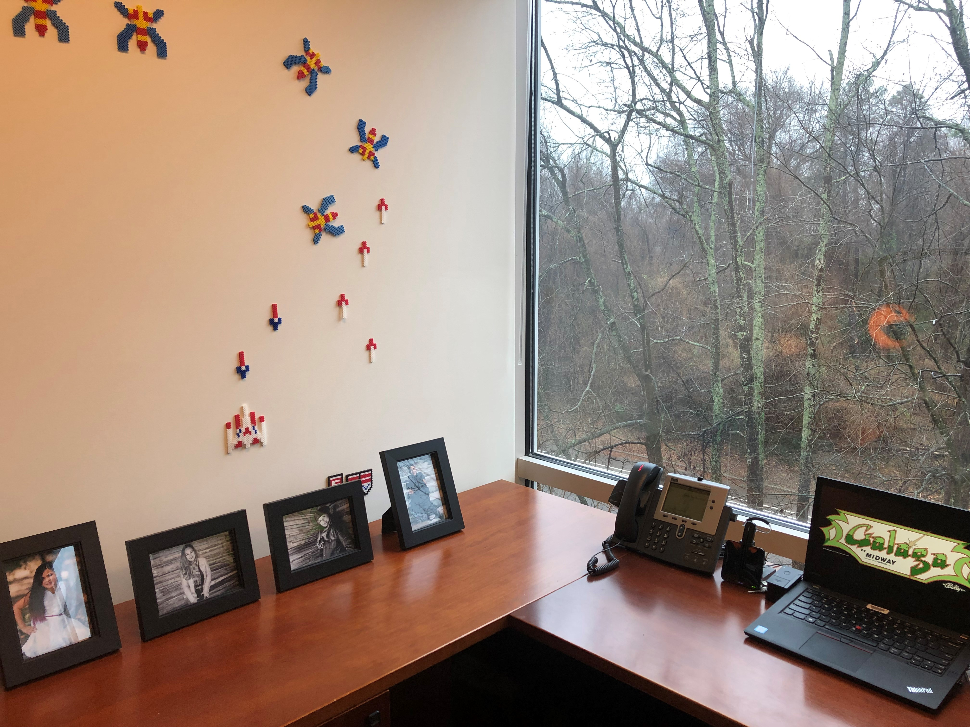


Imagine a visual representation of your deposits with the ability to interact with it
Total Deposits: $87,525
Make a Transfer
Create Budget

Slide 24
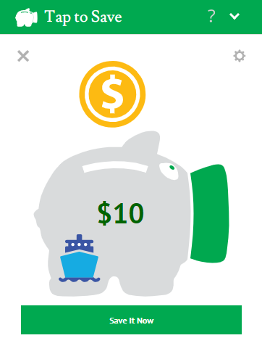
Tap to Save Coastal Credit Union
In the 1st three months
Members performed 7,055 transactions
Totaling $59,035 in savings

Slide 25
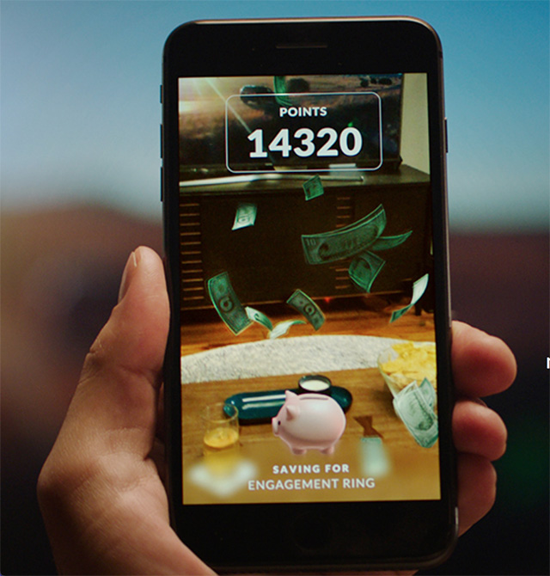
Thinking Augmented Reality
Piggy bank can be virtually seen in front of you
Taps can be virtual
Fun and interactive

Slide 26
Helpful and Practical uses

Slide 27
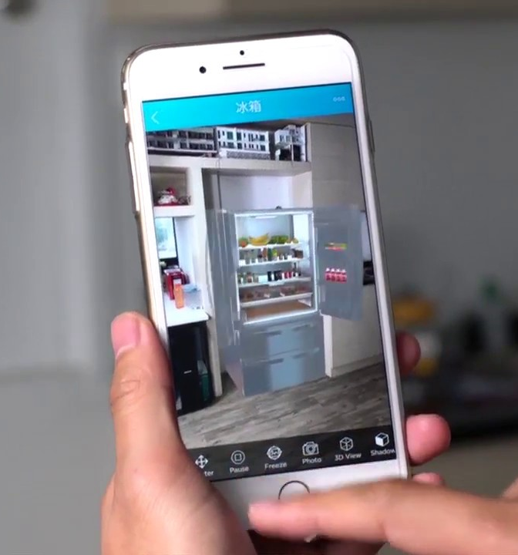
Budgeting
CUFusion.net
AR can display budget and expense
Example:
Point at fridge and get groceries spend
Point to your thermostat and it tells you how much you've spent on electricity
While getting gas, point at the gas cap and know your budget/spend
Transaction History
Groceries
$858.31
Create Budget

Slide 28
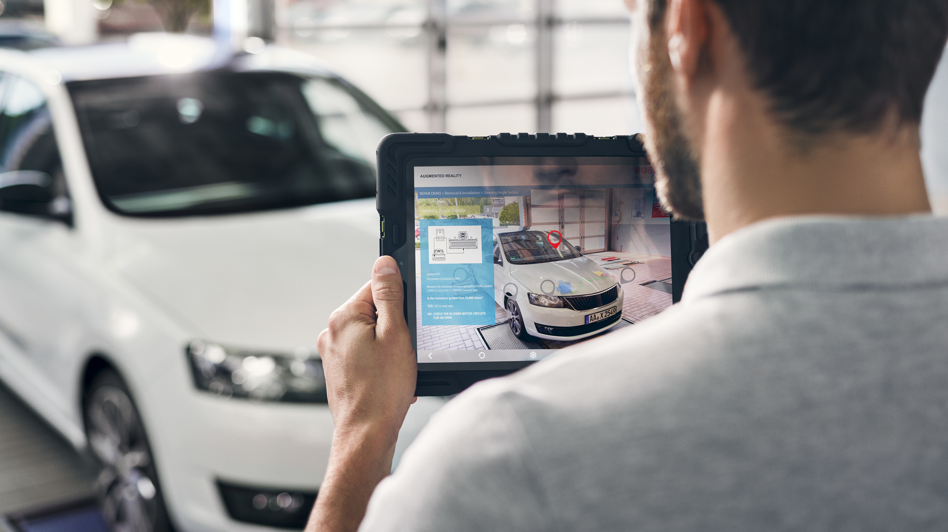
Enhance Car buying experience
Trade-In $15,500
Apply for a Loan
NADA
Get Trade-In Value
Apply for a loan
Compare dealer price quotes
See what’s for sale in the market
Talk to a loan officer

Slide 29
Let’s not forget about the CU
Augmented reality can be used for training
Training on products and procedures
Robbery scenarios
Compliance training
The application within the credit union has no limit

Slide 30
Next Steps

Slide 31
The Ask…
Find a couple credit unions interested in pilot
Find a vendor to provide AR functionality
Define initial AR concepts
Marketing, Enhanced Car Sales, etc…
Approve funding to research vendors

Slide 32










CU Fusion Team
Melissa Castagna
Lauren Kotlarczyk
Ann Riley
Eugenia Guajardo
George Chacon
BCU
Michigan State University FCU
AEFCU
American Airlines FCU
Bethpage FCU
David Jamshid
Antonio Flores
Beverly Smith
Trisha Lee
Mike Crossno
Coastal CU
GECU
Space Coast CU
Stanford FCU
Vantage CU
Team Captain

Slide 33
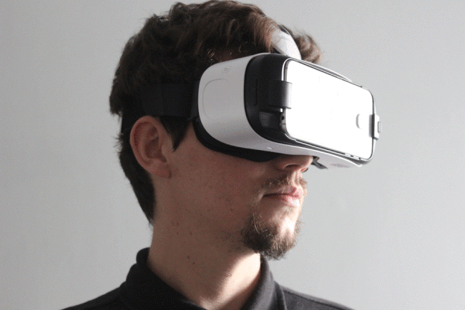

www.cufusion.net

Slide 34
Questions?
Open the door to a virtual world
where our mind is our only boundary
Kent.Zimmer@
membersdevelopment.com
Michael.ElKoubi@
membersdevelopment.com

Slide 35
Appendix

Slide 36
Augmented Reality
AR is set to have a big impact on major industries.
AR can help create greater engagement and interaction.
Many financial institutions are currently using AR.
Notes:
Many institutions are currently using AR:
AR with other FI’s
US Bank and National Bank of Oman- locating ATM
Citibank- enables traders to view stock/market data in 3D
PrivatBank- show financial transactions
Commonwealth Bank of Australia- buy or sell a home
MoneyLion from Utah- visual representation of their balance in account
AR with other companies/brands
IKEA – help visual what things would look like in their homes
Lacoste – customized the size of show to show how it looks
Tesco- partnership with Disney to create selfies with characters
Patron Tequila- create own bottle and virtual tour of distillery

Slide 37
Credit Union Benefits
1
Drive Membership Growth
AR and VR appeals to younger generations of new customers
2
Data Visualization
Help cross-selling opportunities
Provide educational opportunities (ex: seminars)
Close the experience gap
3
Employee Engagement
Reduce employee turnover through efficient training/calibration sessions
Enhance recruitment strategies
Conduct companywide training on product/service and robbery training
4
Reduced Need for Brick and Mortar
Address rural communities
Provide a safer environment for members
Notes:
Drive Membership Growth
Data Visualization
made easy to help in cross selling opportunities
Educational Opportunities and Seminars
Closing the gap between the ITM experience and the traditional face to face experience
3. Employee Engagement
Reduced employee turnover through efficient training/calibration sessions
Enhanced recruitment strategies
Companywide training on product/service and robbery training
4. Reduce the need for brick and mortar facilities (addressing rural areas) and provide a safer environment for members

Slide 38
Member Benefits
1
Accessibility
24/7 access
Enables ATM locators
2
Fun Experience
Find deals at retail partners
Transform a Member’s home into a branch
3
Increased Engagement
Gamification with financial education
Engage new Members through community events
Google Cardboard to engage members/community
4
Brand Awareness
Create a unique brand and enhance Member awareness
Notes:
24/7 access / Distance Issues
find the location of an ATM within a CU partner retailer
Fun vs. Flat experience
find deals at merchants deals at merchants (possibly rewards tied to debit/credit), auto finder, and homes as they pass the property
Transform your home into a branch
Engagement (disengaged and hiring)
gamification with financial education
community events, job fairs, colleges, and to get current/new members engaged
Google Cardboard to engage members/community
Brand awareness

